Slide 1
Center for Secondary Education for Students with Autism (CSESA)

Slide 2
What is CSESA?
Center on Secondary Education for Students with Autism Spectrum Disorders (ASD)
Center funded by the Department of Education to develop and study a comprehensive high school program for students on the autism spectrum

Slide 3
What is CSESA?
Attending to this need:
When young adults with ASD leave the public school system,
“nearly 80% still live at home, almost half have no jobs or postsecondary training, 40% never have contact with friends, 17% never feel hopeful about the future, 21% never engage in outside activities, and many experience a decrease in insurance coverage and therapy services” (Shattuck, 2010).

Slide 4
What is CSESA?
CSESA builds on the work of the National Professional Development Center on ASD (NPDC)
CSESA Foundations
(building teams at the school, assessing program quality, training & coaching in the use of evidence based practices, data collection)

Slide 5
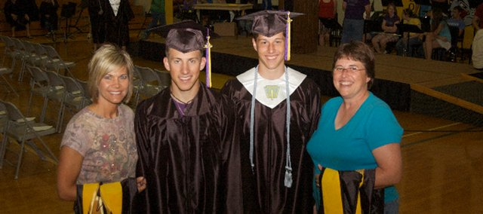
What is CSESA?
Transition & Families
Parent support & education
Community/School mapping
Transition planning
Student involvement in IEP
Career development
CSESA Foundations

Slide 6
What is CSESA?
Social Competence
Structured social skills instruction
(Social Competence Intervention-A)
Peer support
Peer networks
Transition & Families
CSESA Foundations

Slide 7
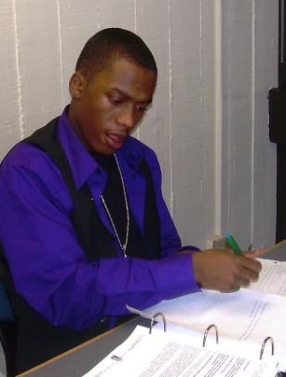
What is CSESA?
Academic
Collaborative Strategic Reading
Alternate Achievement Literacy
Transition & Families
Social Competence
CSESA Foundations

Slide 8
What is CSESA?
Personal Responsibility, Independence, Self-Management (PRISM)
Process for developing goals
Selecting appropriate interventions
Tracking progress
Use of technology
Transition & Families
Social Competence
Academic
CSESA Foundations

Slide 9
How does CSESA work?
School based teams will implement these components across a two-year period with the support and resources from research staff
Teams will select order of implementation
Research team will support school teams (e.g. planning, training, coaching, materials) and plan for future use after project is complete
All students with ASD can access each component
Pieces may vary depending on post-secondary plans

Slide 10
CSESA Study & Timeline
2012-2013
Year 1
Development & piloting of individual model components
(6 sites)
2013-2014
Year 2
Piloting of several components in combination (6 sites)
2015-2016
Year 4
Continue implementation at 30 Cohort 1 sites; enroll 30 more sites (Cohort 2)
2016-2017
Year 5
Continue implementation at 30 Cohort 2 sites, conduct follow-up data collection at Cohort 1 sites
2014-2015
Year 3
Randomized control trial (RCT) of full model at 30 sites across the country (Cohort 1)
15 treatment, 15 control; 12 students per site; each cohort enrolled for 2 years
30 treatment, 30 control
15 treatment, 15 control

Slide 11
CSESA Study & Timeline
Looking for collaborative partners for Years 3-5
Looking for districts that:
Will commit to the project for 2-3 years
Have leaders that are open, flexible, and willing to participate/provide time for team members to participate
Can form a team of district/school professionals to support the implementation of the model
Have high schools that serve at least 12 students with ASD with varied needs
Recognize they may be assigned to a control condition

Slide 12
Why Collaborate with CSESA?
Intervention
Control
Support in developing site based team
Ongoing assessment of program quality
Training and weekly coaching on each component
Financial compensation for team members
Support in developing site based team
Ongoing assessment of program quality
Financial compensation for team members
Training at the end of the study (2017)

Slide 13
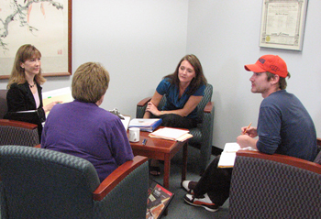
How to Collaborate
Consider the districts you work with:
Are there high schools that could benefit from comprehensive programming for their students with ASD?
Are their district/school leaders that are interested in collaborating with a research team?
Connect CSESA team with potential collaborators
Kara.hume@unc.edu

