Slide 1

Evidence Based Practice Training
Antecedent Based Intervention

Slide 2
Objectives
Become aware of 27 EBPs identified for students with ASD
Describe key steps to using antecedent based interventions
  How to prepare for implementation
  How to implement
  How to assess progress
Identify key pitfalls and ways to avoid them
Identify ways to learn more about how to implement antecedent based interventions

Slide 3
What are EBPs?
Focused interventions that:
Produce specific behavioral and developmental outcomes for a child
Have been demonstrated as effective in applied research literature
Can be successfully implemented in educational settings
(Odom, Colett-Klingenberg, Rogers, & Hatton, 2010)
Notes:
Are used for a limited amount of time,

Slide 4
Evidence – Based Practices
(2014)
Antecedent-based interventions
Cognitive behavioral intervention*
Differential reinforcement
Discrete trial training
Exercise
Extinction
Functional behavior assessment
Functional communication training
Modeling
Naturalistic interventions
Parent-implemented intervention
Peer-mediated instruction/intervention
Picture Exchange Communication System™
Pivotal response training
Prompting
Reinforcement
Response interruption/redirection
Scripting
Self-management
Social narratives
Social skills training
Structured play groups
Task analysis
Technology-aided intervention/instruction
Time delay
Video modeling
Visual supports

Slide 5
For All EBPs
Plan
Choose skill/behavior
Collect baseline data
Implement
Implement steps of EBP well and consistently
Assess
Collect data on student progress
Collect data on your implementation
Make specific decisions related to EBP

Slide 6
Antecedent-Based Interventions
(ABI)

Slide 7

Who uses ABI?
Notes:
ABI is used by a variety of professionals including: teachers, special educators, therapists, and classroom assistants across school and community contexts.

Slide 8
Definition of ABI
The goals of ABI are to
  Identify factors that are reinforcing the interfering behavior
  Modify the environment or activity so that the factor no longer elicits the interfering behavior
ABI is used
  To address both interfering and on-task behaviors
  To decrease repetitive, stereotypical, self-stimulatory, and self-injurious behaviors
  After a functional behavior assessment (FBA) has been conducted to identify the function of the interfering behavior

Slide 9
Behaviors & Skills Addressed
Interfering behaviors
  (e.g., self-injurious, repetitive, and stereotypical behaviors)
Engagement and on-task behaviors

Slide 10
Types of ABI
Common ABI procedures include
  Use highly preferred activities/items to increase interest level
  Change the schedule/routine
  Implement pre-activity interventions
  Offer choices
  Alter the manner in which instruction is provided
  Enrich the environment so that learners with ASD have access to sensory stimuli that serve the same function as the interfering behavior
*ABI strategies often are used in conjunction with other evidence-based practices*

Slide 11
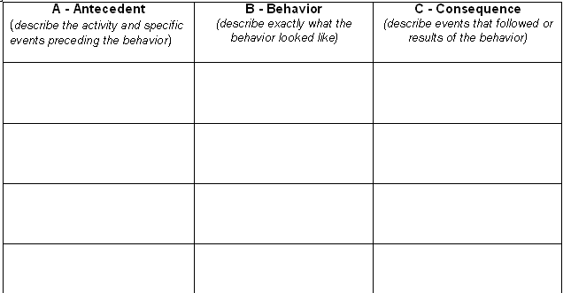
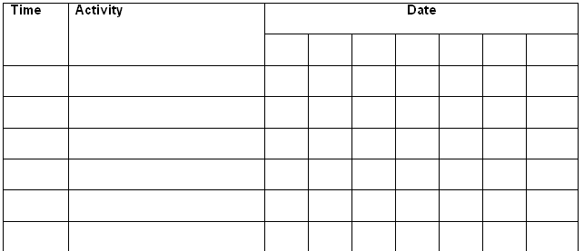
ABI
Steps for Implementation
Step 1. Identify the Interfering Behavior using
A-B-C Data Charts
Scatterplots

Slide 12
ABI
Steps for Implementation
Step 2. Collect Baseline Data using
Frequency Data Charts
Date | Bites hand | Total | Before, during, or after reinforcement
7/26/08 | XXXXXXXXXXXXX | 13 | Before
7/27/08 | XXXXXXXXXXXXXXXX | 16 | Before
7/28/08 | XXXXXXXXXXXXXX | 14 | Before
7/29/08 | XXXXXXXXXXX | 11 | Before
Duration Data Charts
Date | Start time | End Time | Total minutes | Before, during, or after reinforcement
7/26/08 | 9:00 | 9:15 | 15 | Before
7/27/08 | 9:05 | 9:20 | 15 | Before
7/28/08 | 9:00 | 9:13 | 13 | Before
7/29/08 | 9:10 | 9:30 | 20 | Before

Slide 13
ABI
Steps for Implementation
Step 3. Implement ABI
Identify a strategy to address the behavior (can choose more than 1 if needed)
  Use learner preferences
  Change schedules/routines
  Implement pre-activity interventions
  Use choice-making
  Alter how instruction is delivered, and/or
  Enrich the environment

Slide 14
ABI
Steps for Implementation
Step 3. Implement ABI
Ignore interfering behavior when it occurs
Provide reinforcement for
  Engagement in appropriate behavior
  Completion of the weekly behavioral objective

Slide 15
ABI
Steps for Implementation
Step 3. Implement ABI
Create a lesson plan
Date: Week of 11/17/08-11/21 /08 Classroom: Math class Teacher: Mrs. Banks Learner’s name: Kenny Interfering behavior: Banging head on desk when asked to complete an in-class assignment
Objectives for this week: Kenny will complete one in-class assignment with minimal head banging (i.e., less than three times).
Strategy: Altering how instruction is delivered To implement the strategy, I will: Give Kenny written instructions for assignments rather than providing them verbally. Modify worksheet instructions by providing Kenny with a checklist for completing the task. Ignore Kenny when he bangs his head while also pointing to written instructions again. Let Kenny have 10 minutes of computer time after completing an in-class assignment with minimal head banging (i.e., less than three times).
Materials needed: Sentence strips: “Complete these math problems.” “Finish your work.” Checklists for all worksheets that need to be completed this week.

Slide 16
ABI
Steps for Implementation
Step 4. Monitor learner progress
  Use progress monitoring data to evaluate whether the interfering behavior is decreasing as result of the intervention
  Use the same data collection sheets used previously to collect baseline data to track learner progress
    Use to adjust intervention strategies if the interfering behavior does not decrease
Date | Bites hand | Total | Before, during, or after reinforcement
7/26/08 | XXXXXXXXXXXXX | 13 | Before
7/27/08 | XXXXXXXXXXXXXXXX | 16 | Before
7/28/08 | XXXXXXXXXXXXXX | 14 | Before
7/29/08 | XXXXXXXXXXX | 11 | Before
7/30/08 | XXXXXXXXX | 9 | During
7/31/08 | XXXXXX | 6 | During
8/01/08 | XXX | 3 | During

Slide 17
ABI
Steps for Implementation
Step 4. Monitor learner progress
Teachers/practitioners use progress monitoring data to adjust intervention strategies if the interfering behavior does not decrease
If the interfering behavior is not decreasing, teachers/ practitioners must try to identify potential reasons
The following questions may be helpful during this problem-solving process:
  Is the interfering behavior well defined? That is, is it observable and measurable?
  Are ABI strategies being implemented consistently by all staff?
  Do the ABI strategies directly address the function of the behavior identified during the FBA?

Slide 18
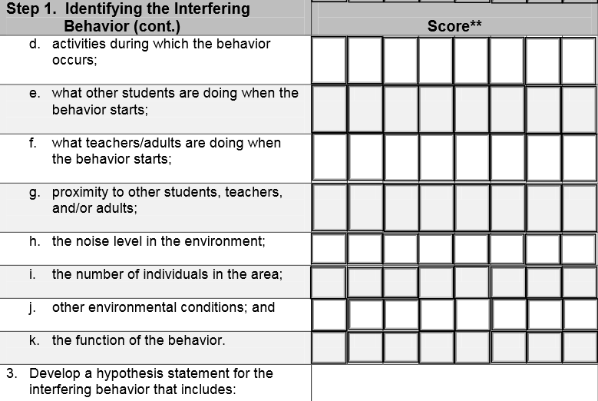
ABI
Fidelity Checklist

Slide 19

Video Example
Notes:
This video example takes place in a high school classroom. The video is brief, however, the teacher notices an interfering behavior and you will see what she does to incorporate an ABI strategy.

Slide 20

What did you notice?
Describe the teacher’s interaction with the student
Points to consider
  Identification of needs
  What did the ABI address?

Slide 21
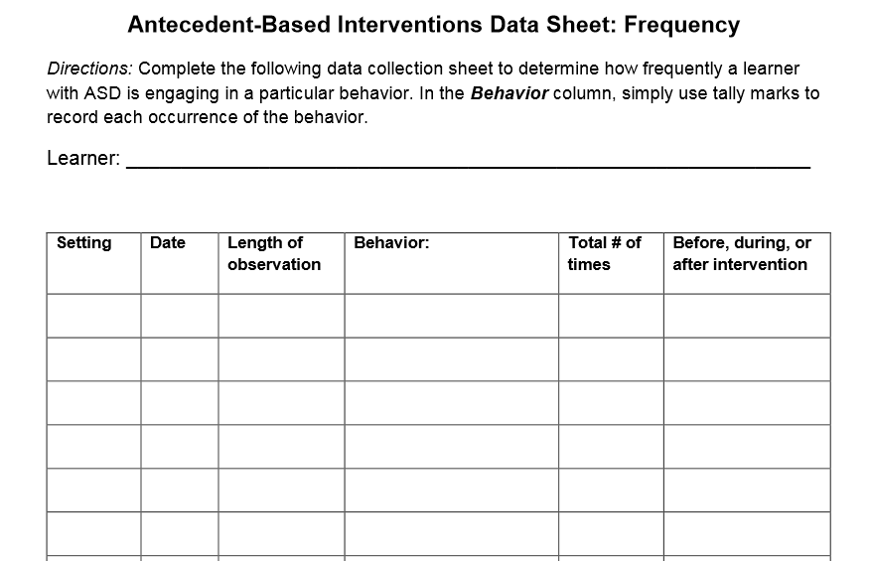
Collecting Data
Frequency
Screenshot of datasheet

Slide 22
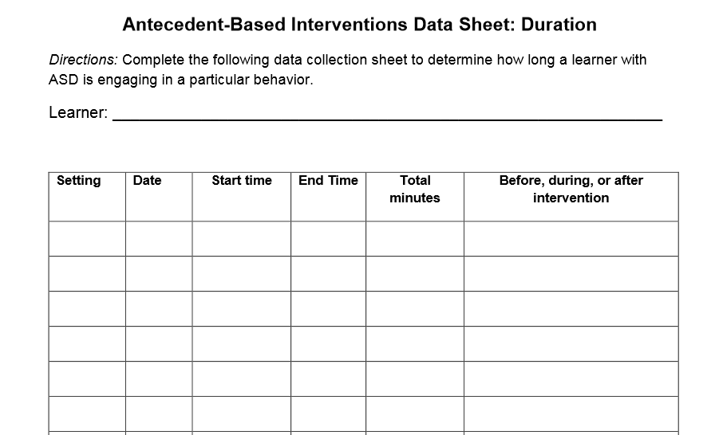
Collecting Data
Duration

Slide 23
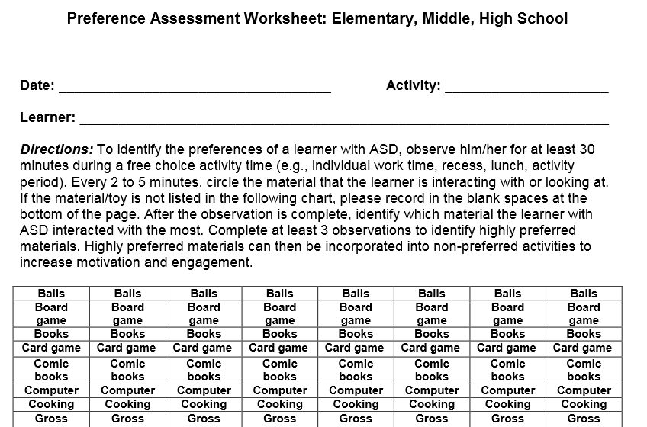
Collecting Data
Preference Assessment

Slide 24

Common Problems and Solutions
Problem | Solution
What are some approaches that can help me identify my student’s preferences and reinforcers? | Teachers/practitioners may also take into account answers to the following questions when trying to identify learners' preferences and interests: What makes the learner smile and laugh? What makes the learner happy and feel good? What kinds of things get the learner excited? What are the learner's favorite things to do? What does the learner work especially hard at doing? What gets and keeps the learner's attention? What gets the learner to try new things?
My student is showing a variety of behaviors at once in response to an event in the classroom. How can I identify what exactly is the interfering behavior? | Conducting an FBA will be helpful in identification of interfering behaviors as well as the function of each. This can aid in capturing the various responses the student may have in the classroom to the event. You may choose the most prominent behavior and in the implementation of ABI start to see other potential interfering behaviors reduce in frequency

Slide 25

CAUTION!
Avoid
Reinforcing Interfering Behavior

Slide 26
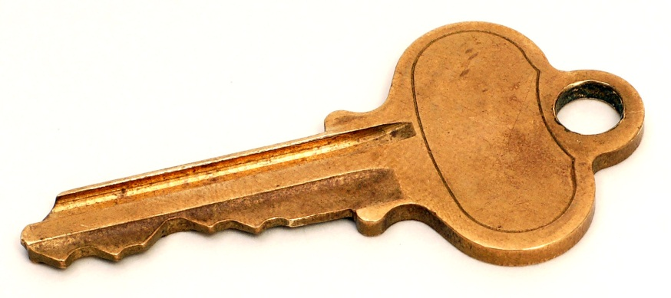
The Key to Effective ABI
ABI strategies are implemented consistently by all staff
ABI strategies directly address the function of the behavior identified during the FBA

Slide 27
To Learn More…
Find additional information on ABI and other Evidence Based Practices within the following resources.

Slide 28
Evidence-based Practice Resources
EBP literature review
http://autismpdc.fpg.unc.edu/sites/autismpdc.fpg.unc.edu/files/2014-EBP-Report.pdf
EBP Case Studies for High School
EBP Briefs (http://autismpdc.fpg.unc.edu)
  Overview
  Evidence Base
  Steps for Implementing
  Implementation Checklist
  Sample Data Collection Forms (optional)
Autism Internet Modules
(http://www.autisminternetmodules.org)

Slide 29

EBP Case Studies for High School
http://csesa.fpg.unc.edu/resources/evidence-based-practices-case-studies

Slide 30
Example: Step-by-Step Directions

Slide 31
Example: Implementation Checklist
 | Observation | 1 |  | 2 | 3 | 4 | 5 | 6 | 7 | 8
 | Date | 6/14/11
 | Observer’s Initials | AC
Planning (Steps 1 – 5)
Step 1. Identifying and Setting Up the Device |  | Score**
Select an appropriate device, taking into account how the information is displayed, the learner’s present and potential abilities (e.g., attention span, experience with symbols, ability to establish joint attention), portability of the device, available training and technical assistance, and funding sources. |  | 2
Introduce the device to the learner by having a device with few symbols and/or buttons with nothing on them. |  | 2
Include desirable and undesirable symbols to facilitate the learner’s ability to discriminate. |  | 0
Step 2. Introducing Direct Support Persons to the Device
Team members are identified and trained in how to program and use the device. |  | 2
One or two key members of the team are identified as primary contacts regarding its use. |  | 0
**Scoring Key: 2 = implemented; 1 = partially implemented; 0 = did not implement; NA = not applicable

Slide 32

EBP Literature Review

Slide 33
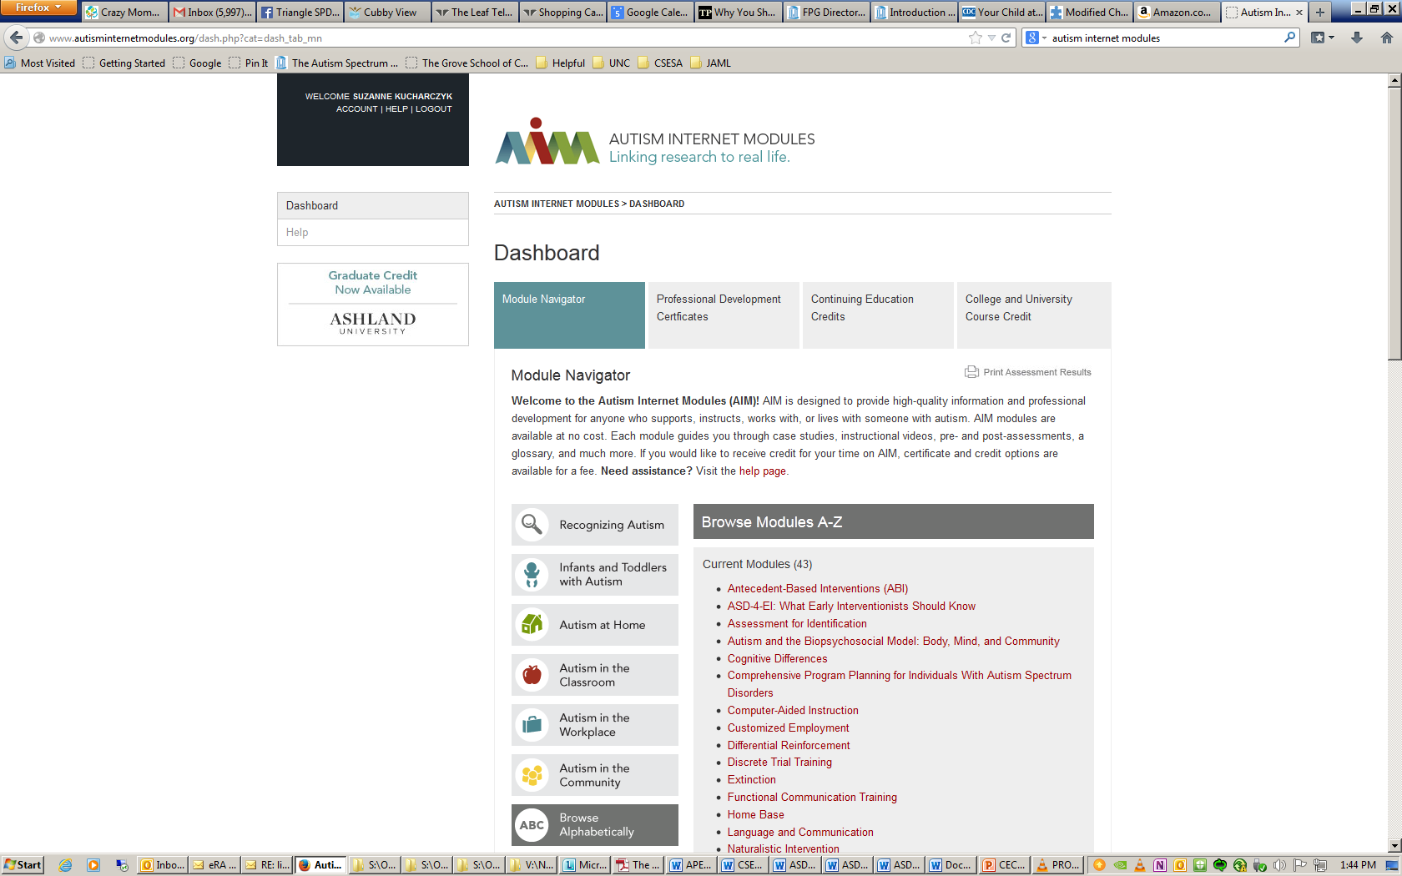
Autism Internet Modules
http://www.autisminternetmodules.org/

Slide 34

Action Plan
What will I do tomorrow:
1.
2.
3.

Slide 35

Questions

