Slide 1
Evidence Based Practice Training
VISUAL SUPPORTS

Slide 2
Objectives
What are evidence-based practices?
Identify 27 EBPs for students with ASD
Visual supports
Target skills addressed
Examples
Steps for implementation
Keys to effective use
Resources to learn more about implementing visual supports

Slide 3
What are EBPs?
Focused interventions that:
Produce specific behavioral and developmental outcomes for a child
Have been demonstrated as effective in applied research literature
Can be successfully implemented in educational settings
(Odom, Colett-Klingenberg, Rogers, & Hatton, 2010)
Notes:
Are used for a limited amount of time,

Slide 4
Evidence – Based Practices (2014)
Antecedent-based interventions
Cognitive behavioral intervention*
Differential reinforcement
Discrete trial training
Exercise
Extinction
Functional behavior assessment
Functional communication training
Modeling
Naturalistic interventions
Parent-implemented intervention
Peer-mediated instruction/intervention
Picture Exchange Communication System™
Pivotal response training
Prompting
Reinforcement
Response interruption/redirection
Scripting
Self-management
Social narratives
Social skills training
Structured play groups
Task analysis
Technology-aided intervention/instruction
Time delay
Video modeling
Visual supports

Slide 5
For All EBPs
Plan
Choose skill/behavior
Collect baseline data
Implement
Implement steps of EBP well and consistently
Assess
Collect data on student progress
Collect data on your implementation
Make specific decisions related to EBP

Slide 6
VISUAL SUPPORTS

Slide 7
Why use visual supports?
When we present information verbally, the words are only available for a brief moment.
When we present information visually, it can be there for as long as the individual needs it.

Slide 8
Who uses visual supports?

Slide 9
Definition of Visual Supports
Any tool presented visually that supports an individual as he or she moves through the day.
Enhances the individual's ability to understand, anticipate, and participate
Supplements verbal instruction
(National Research Council, 2001)

Slide 10
Target Skills Addressed
Adaptive behavior skills including:
task engagement
independent performance
transitions across activities
increasing response chain length
Social initiation and interaction skills
Reducing self-injurious behavior

Slide 11
Types of Visual Supports
Pictures
Written words
Objects within the environment
Visual boundaries
Schedules
Maps
Labels
Organization systems
Timelines
Scripts

Slide 12
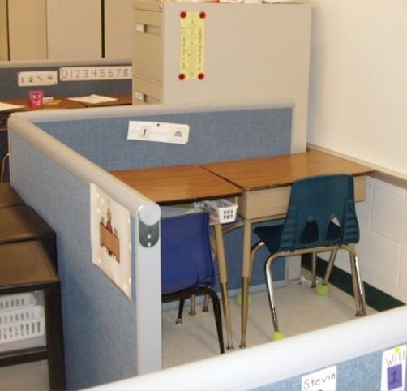
Examples of Visual Supports
Visually-defined work area
Snack choice visual

Slide 13
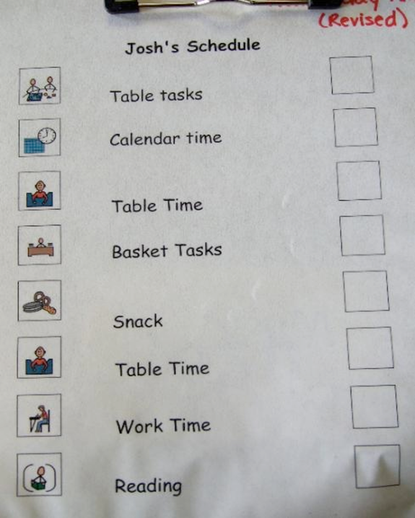
Examples of Visual Supports
Class agenda
Individual schedule
Notes:
V:\NPDC_VIDEO_FOLDERS\autismpdc\autismpdc_VIDEOS\3_APPROVED Video Clips-Needs Description\Prompting\1. Early Intervention PROMPTEI4

Slide 14
Examples of Visual Supports
Individual schedule

Slide 15
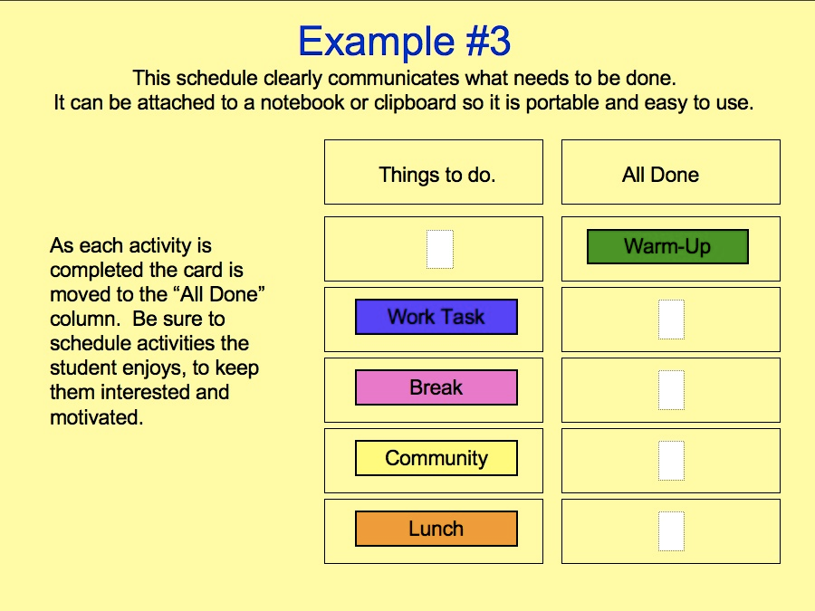
Examples of Visual Supports
Individual schedule

Slide 16
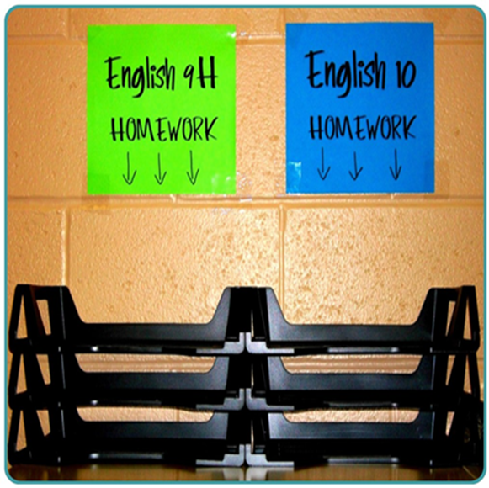
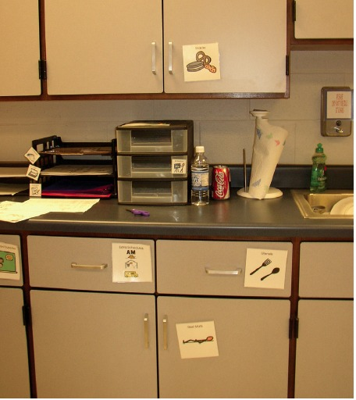
Examples of Visual Supports
Visual labels
Visual labels

Slide 17
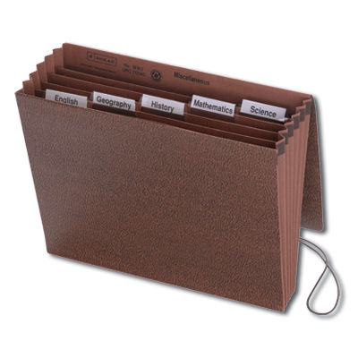
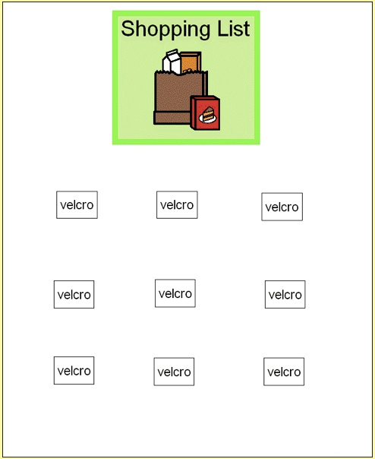
Examples of Visual Supports
Organizational system - school
Organizational system - community

Slide 18
Examples of Visual Supports
Script
When the person taking the order at McDonald's says: "Can I help you?" I say: "I want a Quarter Pounder™with cheese only on it." They usually say "Quarter Pounder™,cheese only?" And I say: "Yes, please.“
The person taking my order usually says: "Do you want fries?" And I say, "Yes, please, medium fries and a medium Sprite to drink.“
The person behind the counter then asks me if that will be all, and I say: "Yes, thank you.“
I give the person my money and they give me my change. I take one step to the side at the counter so the person behind me can give their order while I wait for my order to be put on the counter.

Slide 19
Examples of Visual Supports
Transition support

Slide 20
Steps for Implementation
Link to EBP Brief for Visual Supports

Slide 21
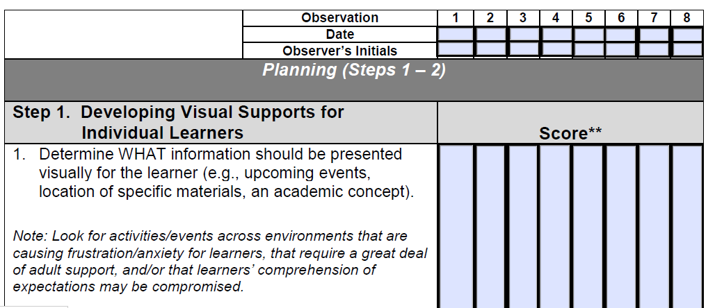
Implementation Checklist for Visual Supports
**Scoring Key: 2 = implemented; 1 = partially implemented; 0 = did not implement; NA = not applicable
Link to EPB - Visual Supports

Slide 22
Collecting Data – Visual Schedule
With visual supports, Tom will transition between all
activities in language arts class with no more than 2 verbal
prompts per day across one week of data.
Did Tommy transition between all activities in Language Arts class with no more than 2 prompts?
(***+ means yes, - means no***)
Week: | Monday | Tuesday | Wednesday | Thursday | Friday | Goal met?
9/1 | - | - | - | + | - | N
9/8 | + | + | - | - | - | N
9/15 | + | + | + | + | + | Y
9/22 |  |  |  |  |  | Y / N
9/29 |  |  |  |  |  | Y / N

Slide 23
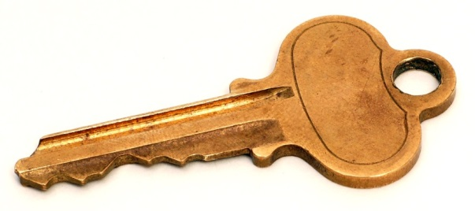
The Key to Effective Use of Visual Supports
Individualize it to the needs of the student
Think of the size and portability of the visual
Consider all settings: home, school, work, and the community
Attach meaning to the visual support using key words and phrases
Stick with it – it may take time before you see results
Notes:
discriminative stimulus a stimulus, associated with reinforcement, that exerts control over a particular form of behavior; the subject discriminates between closely related stimuli and responds positively only in the presence of that stimulus.

Slide 24
Summary:
When individuals with ASD are given the opportunity to learn with visual supports or cues they:
Complete more tasks by themselves therefore increasing their independence
Learn more rapidly
Demonstrate decreased levels of frustration, anxiety, and aggression related to task completion
Adjust more readily to changes in their environments (Savner & Myles, 2000)

Slide 25
To Learn More…
Find additional information on Visual Supports and other Evidence Based Practices within the following resources.

Slide 26
Evidence-based Practice Resources
EBP literature review http://autismpdc.fpg.unc.edu/sites/autismpdc.fpg.unc.edu/files/2014-EBP-Report.pdf
EBP Case Studies for High School
EBP Briefs (http://autismpdc.fpg.unc.edu)
Overview
Evidence Base
Steps for Implementing
Implementation Checklist
Sample Data Collection Forms (optional)
Autism Internet Modules (http://www.autisminternetmodules.org)

Slide 27
EBP Case Studies for High School
http://csesa.fpg.unc.edu/resources/evidence-based-practices-case-studies

Slide 28
EBP Literature Review

Slide 29
Autism Internet Modules
http://www.autisminternetmodules.org/

Slide 30
Action Plan
What will I do tomorrow:
1.
2.
3.

Slide 31
Questions

